Slide 1
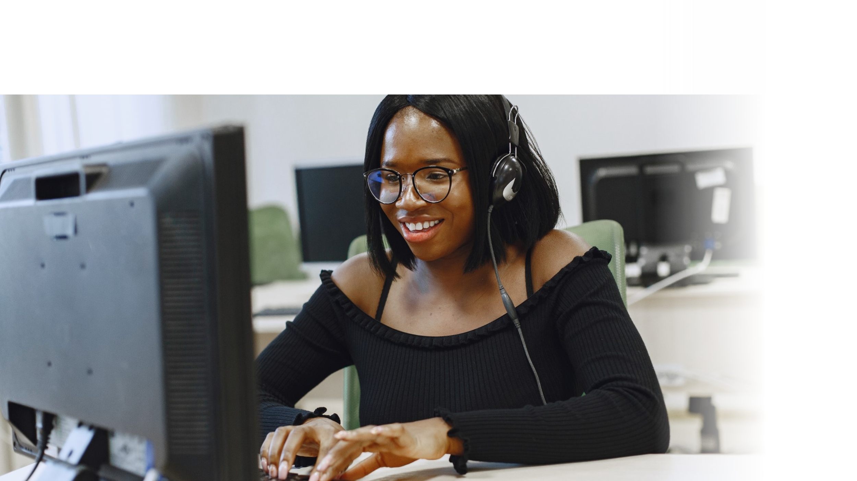



DIGITAL LITERACY
SKILLS
ADVANCED USERS

Slide 2
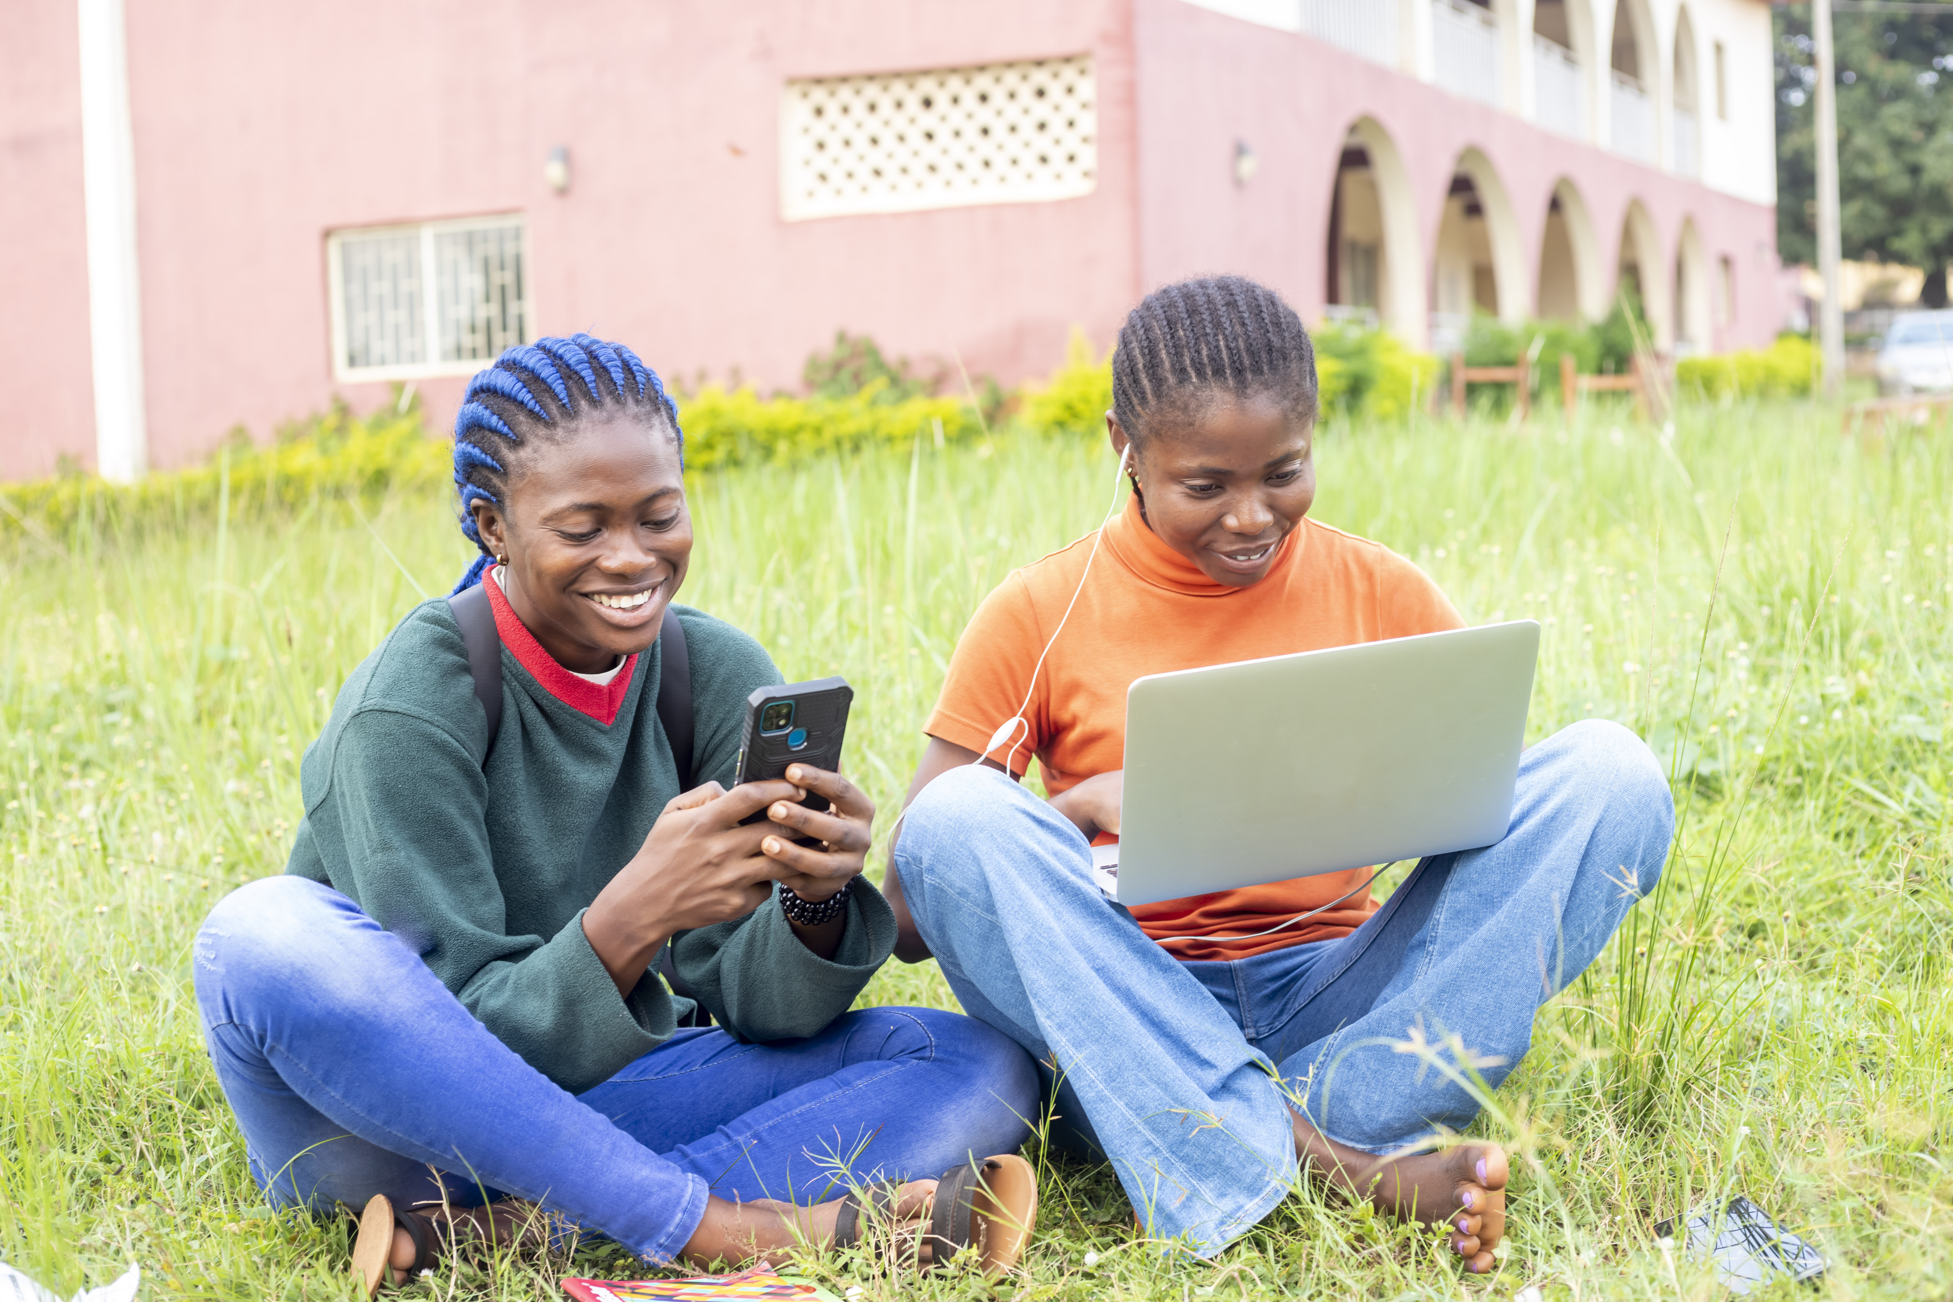
Module 5
Safety and security

Slide 3

1
Unit 1: Protecting devices

Slide 4
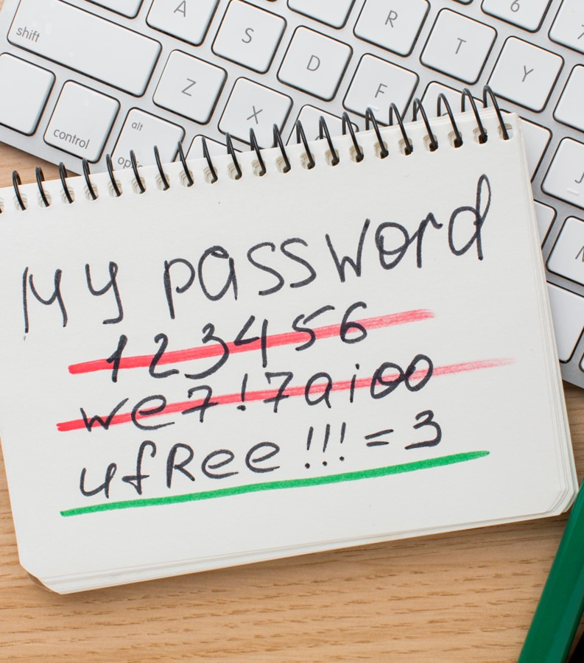
Security and passwords
Change default log-in passwords and usernames
Devices come with default passwords.
If you leave these unchanged, you create opportunities for unauthorized access.
Use strong and unique passwords
Choose strong passwords to help secure your devices.
Don’t use the same password with multiple accounts.

Slide 5

Why do you need strong passwords?
Hackers are a threat to your information.
If someone has access to your password, they could also pretend to be you.
Protect information by ensuring that only authorized people have access to it. Authenticate anyone who requests access.
Passwords only work if they are complex and private.

Slide 6
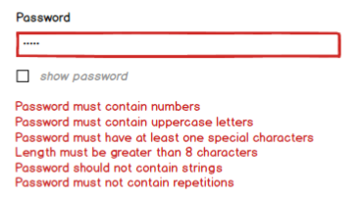
Length and complexity
Use a password or passphrase longer than the minimum allowed characters.
Include upper and lowercase letters, numbers, and special characters.
Avoid common phrases, famous quotations, and song lyrics.

Slide 7
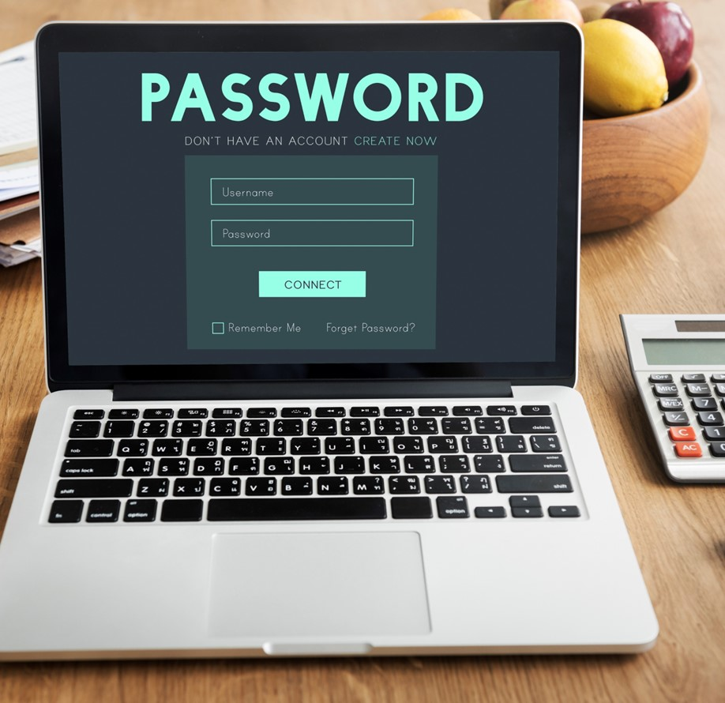
Dos and don'ts
Don’t reuse passwords. Reusing a password endangers accounts just as much as using a weak password.

Slide 8
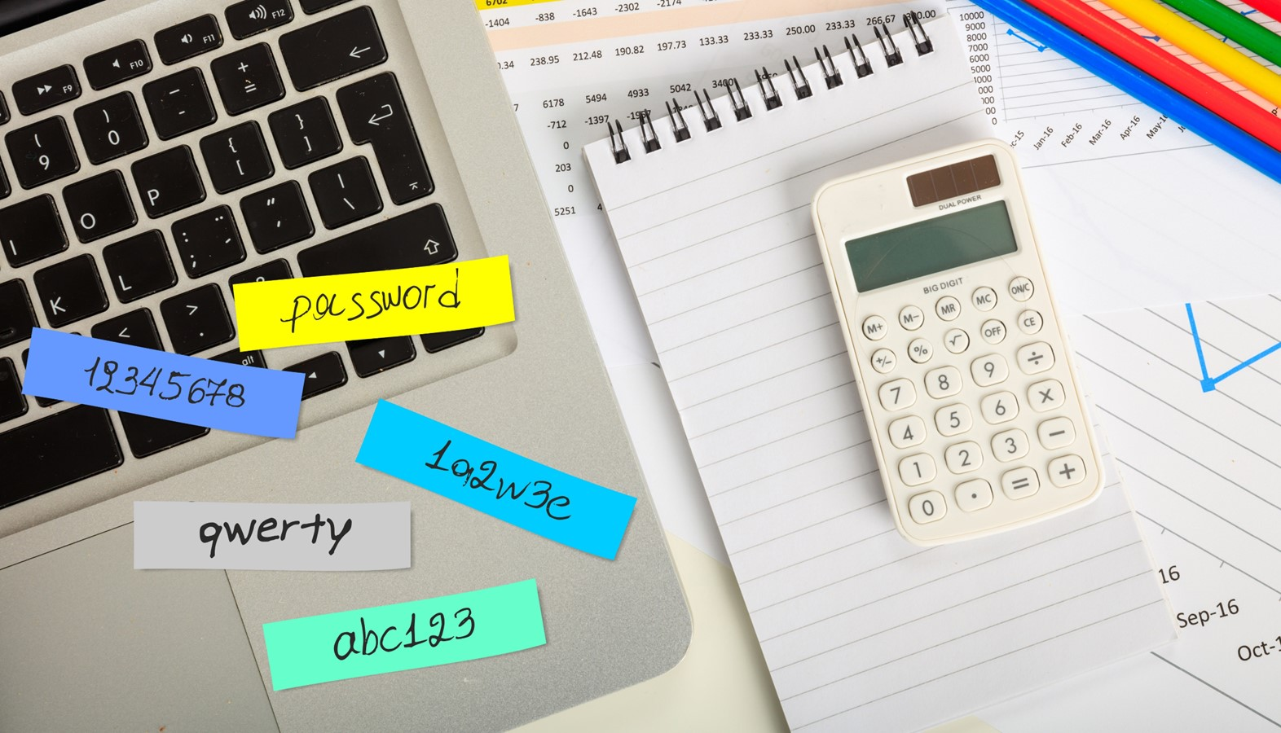
Dos and don'ts
Use these techniques to develop unique passwords for each of your accounts:
Use different passwords on different systems and accounts.
Use a password longer than the minimum allowed password.
Develop ways to remember complex passwords.
Consider using a password manager program.
Do not use passwords that are based on personal information.
Do not use words that can be found in any dictionary.

Slide 9
Improving computer security
1
2
3
Secure your home network
Secure your router – the first device that receives information from the Internet.
Home network security
Home network security – the protection of a network that connects devices – such as routers, computers, smartphones – to each other and to the Internet within a home.
Regular software updates
Update software regularly.

Slide 10

Software updates
Find software updates to install
Software updates are advertised for users to download and install.
Some software will automatically check for updates.
Avoid updating software (automatically or manually) while connected to public networks
If updates must be installed over a public network, use a Virtual Private Network (VPN) connection.

Slide 11

Best practices for software updates
Follow these guidelines about software updates:
Enable automatic software updates whenever possible.
Do not use unsupported EOL software.
Always visit supplier sites directly.
Avoid software updates while using public networks.
Disable all unnecessary services to reduce the chance of attack on your devices.
Adjust factory-default configurations on software and hardware.

Slide 12

Increasing security
Run up-to-date antivirus software
Install a network firewall
Regularly back up your data
Increase wireless security

Slide 13

Malicious code
Malicious code is unwanted files or programs that can cause harm to a computer or compromise data stored on a computer. Various classifications of malicious code include:
viruses
worms
trojan horses
malicious data files.

Slide 14
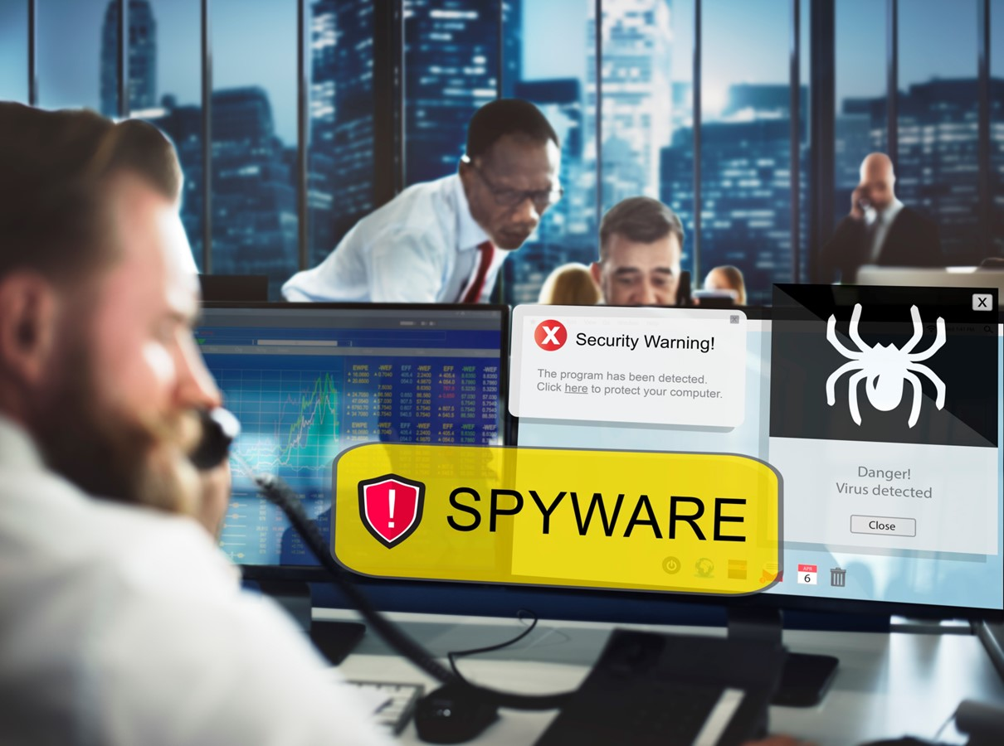
How do you recover if you become a victim of malicious code?
Using antivirus software is the best way to defend your computer against malicious code.
Follow these steps:
Step 1: Minimize the damage.
Step 2: Remove the malicious code.
You can’t remove every hazard, BUT you can reduce your risk and strengthen your protection against malicious code.

Slide 15
Skills to practise
Check security on your device
Go to the settings of the device that you are using and check if any security updates are available.
Notify your facilitator or the network administrator who will have access to install the updates.
Continue >

Slide 16
Skills to practise
2. Research security software
Research on the internet and choose which security software you would install if you owned the device.
Check the pricing and how to install it.
Check if your computer is infected by a virus.
Go to the settings of the device that you are using and see if you have access to run a virus scan.
Complete an internet search on how to run a virus scan on a laptop, tablet, and smart phone.
Continue >

Slide 17
Skills to practise
3. Configure the firewall on your device
Complete an internet search on how to configure and modify a firewall on a laptop, tablet, and smartphone.
Configure or modify the firewall and security settings of your digital devices.
If you do not own the device that you are using, you should not have access to modify or configure the firewall.
Continue >

Slide 18
All back covers should include
contact information of the section
producing the work.
© United Nations Children’s Fund (UNICEF) [month and year of publication]

